Slide 1
ELK basic inflearn 메모

Slide 2
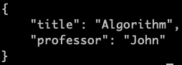
classes
class

